Slide 1
STUDENT DOCUMENT SIMILARITY ANALYSIS
Team Members:
J. SIMRAN - 2520030166
K. ANUSRI - 2520030432
SIRIPURAPU RIKHIL - 2520030480

Slide 2
ABSTRACT
Our project aims to develop a document similarity checking application using the Z-Algorithm. The application compares the textual content of two PDF documents to identify matching or duplicated content. By extracting text from the uploaded PDFs and applying efficient string-matching techniques, the system can determine the similarity between the documents and display the matching portions.

Slide 3
PROBLEM STATEMENT
In a college, an assignment is given to students with a requirement to submit an individual project report. Student A completes the assignment genuinely by doing their own work and prepares a PDF report. Student B does not complete the work independently and asks Student A for their PDF. Student B then copies the entire document and only changes personal details such as the name and roll number before submitting it as their own work.
When the instructor receives both submissions, manually comparing lengthy PDF documents to identify such copied content is time-consuming and difficult.
Therefore, an efficient system is needed to compare two PDF documents, identify the matching content, and calculate their similarity percentage.

Slide 4
PROPOSED FUNCTIONALITIES
1. PDF Upload
Upload two PDF documents for comparison.
2. Text Extraction
Extract textual content from both PDFs.
3. Z-Algorithm Based Matching
Compare the extracted text using the Z-Algorithm.
4. Similarity Calculation
Calculate the percentage of matching content.
5. Visual Results
Display the similarity percentage and matching portions.
Similarity Classification
80% and above: Completely Duplicated
50% – 79.99%: Moderately Similar
Below 50%: Not Duplicated

Slide 5
TOOLS AND TECHNOLOGIES
TOOLS | TECHNOLOGIES
Z-Algorithm | Core string-matching algorithm
PDF Text Extraction | Extract text from uploaded PDFs
Document Comparison | Compare extracted text and identify matching content
User Interface | Upload PDFs and display similarity results

Slide 6
EXPECTED OUTCOME
  Compare two PDF documents and identify similar content.
  Generate a similarity percentage based on the matching text.
  Identify and display matching portions of the documents.
  Efficiently detect copied or duplicated content using Z-Algorithm-based string matching.
Expected Result: A simple and efficient document similarity-checking application.

Slide 7
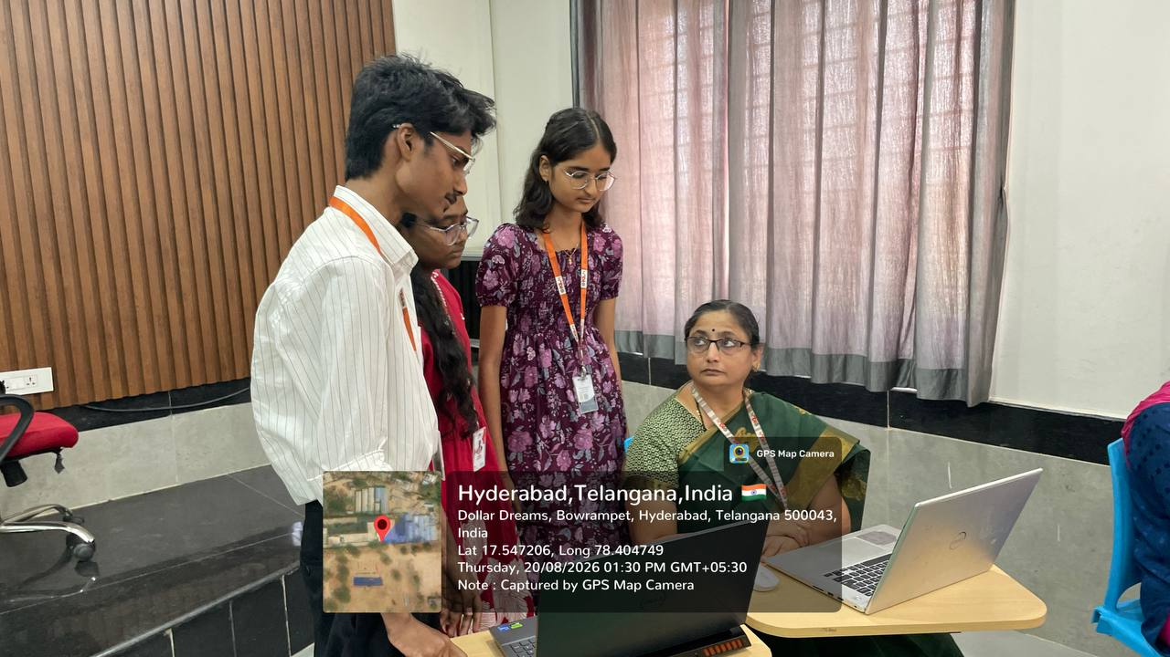

Slide 8
THANK YOU!

